Slide 1
Documentation and Metadata
Bruna Piereck and Alexander Botzki
This material contains extracts and adaptations from the “Metadata & Findability” session of “FAIR training material made by design” course, CCBYSA

Slide 2
Which kinds of data/documents we have?
Notes:
Let students answer the question

Slide 3
Which kinds of data/documents we have?
Samples
Images
Code
Articles
Documentation
Presentations, Posters
Protocols / Resources of Products
Data (e.g. readouts - various file formats, …)
Notes:
https://docs.google.com/presentation/d/1ZcFJpbXtxT4Qa6wgffV_oEX8_cZfzM8B-VlMH0Cff0I/edit#slide=id.g301c2976dd9_0_8

Slide 4
Data vs Metadata
Data itself
Data descriptor (metadata)
Notes:
Examples to help explaining:
In a plant experiment. Omics (DNA, RNA, Prot) are the data along with their measurements and annotation. Metadata are describing the data such as plant size, time and date of collection, temperature, maybe weather if not growing in a greenhouse, who collected, etc …
In another example if you are interviewing people to collect some data, like mental health history or cardiovascular diseases that you want to check the correlation with job and income, these are your data. However you might still have information on how data was collected, in which period of time it was collected, what is the nationality and ethnicity of these people, etc.

Slide 5
Documentation
Consideration with the publishing in mind
Notes:
https://www.freepik.com/free-photo/impressed-young-guy-student-wearing-backpack-with-glasses-holding-looking-book-scratching-head-isolated-orange-wall_17547116.htm#fromView=search&page=1&position=27&uuid=2d03d162-447c-4c25-b52b-22e0f295beed

Slide 6

General consideration with the publishing in mind
Documentation
For someone else
known to the field
Can not misinterpret it
By stockking
on freepik.com
https://rdmkit.elixir-europe.org/metadata_management
Notes:
https://www.freepik.com/free-photo/impressed-young-guy-student-wearing-backpack-with-glasses-holding-looking-book-scratching-head-isolated-orange-wall_17547116.htm#fromView=search&page=1&position=27&uuid=2d03d162-447c-4c25-b52b-22e0f295beed

Slide 7


General consideration with the publishing in mind
Documentation at two levels
A. Project or Study: Title Summary Aims Authors Funds Methods License Data sets ID Folder structure File naming
Data-level: Sample
Analysis
Results
By freepik
By pch.vector on freepik.com
https://rdmkit.elixir-europe.org/metadata_management
Notes:
https://www.freepik.com/free-vector/hand-drawn-gathering-data-business-concept_20289426.htm#fromView=search&page=1&position=8&uuid=13dd6e82-c796-4538-9fb2-ffd0657164cc
https://www.freepik.com/free-vector/male-hand-holding-folder-with-documents-flat-vector-illustration-businessman-holding-red-file-important-business-real-estate-documents-stationery-application-meeting-concept_27572968.htm?log-in=google#fromView=search&page=1&position=7&uuid=07b0b1f1-775b-4fc7-8932-41366a0bc153

Slide 8
General consideration with the publishing in mind
Documentation at two levels
A. Data Sample
Analysis
Results
By freepik
https://rdmkit.elixir-europe.org/metadata_management
Notes:
https://www.freepik.com/free-vector/hand-drawn-gathering-data-business-concept_20289426.htm#fromView=search&page=1&position=8&uuid=13dd6e82-c796-4538-9fb2-ffd0657164cc
https://www.freepik.com/free-vector/male-hand-holding-folder-with-documents-flat-vector-illustration-businessman-holding-red-file-important-business-real-estate-documents-stationery-application-meeting-concept_27572968.htm?log-in=google#fromView=search&page=1&position=7&uuid=07b0b1f1-775b-4fc7-8932-41366a0bc153

Slide 9

General consideration with the publishing in mind
Both the study- and data-level documentation must be:
Generated as early as possible in the research process
Maintained, in order to be accurate and complete
By vectorjuice on freepik.com
https://rdmkit.elixir-europe.org/metadata_management
Notes:
https://www.freepik.com/free-vector/cloud-collaboration-abstract-concept-illustration_20770245.htm#fromView=search&page=1&position=2&uuid=ec61cc9f-27ed-477b-b71e-96b38e6a1678

Slide 10
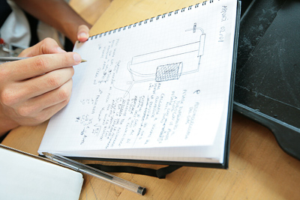

Why would I use an ELN for documentation?
Paper replacement
Project-based system
Share data
Experiments, protocols, ...
Standardization of experiments
Templates
Intellectual property protection
Data stored in central database
Eventually Office integration
MS Office: Word, Excel, PowerPoint
Search function
Advanced search

Slide 11
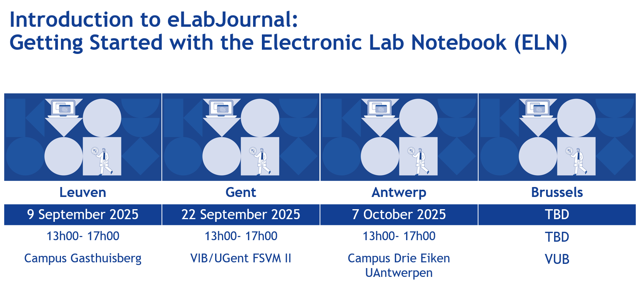

Slide 12
Material & Methods
Documentation and Publishing
Notes:
https://www.freepik.com/free-photo/impressed-young-guy-student-wearing-backpack-with-glasses-holding-looking-book-scratching-head-isolated-orange-wall_17547116.htm#fromView=search&page=1&position=27&uuid=2d03d162-447c-4c25-b52b-22e0f295beed

Slide 13

Material & Methods
Documentation and Publishing
By rawpixel.com at frepik.com
Notes:
https://www.freepik.com/free-photo/flowchart-information-methodology-operation-icon_18092018.htm#fromView=search&page=1&position=0&uuid=75da79d2-6d6f-4fa4-b976-c099b19183f1

Slide 14
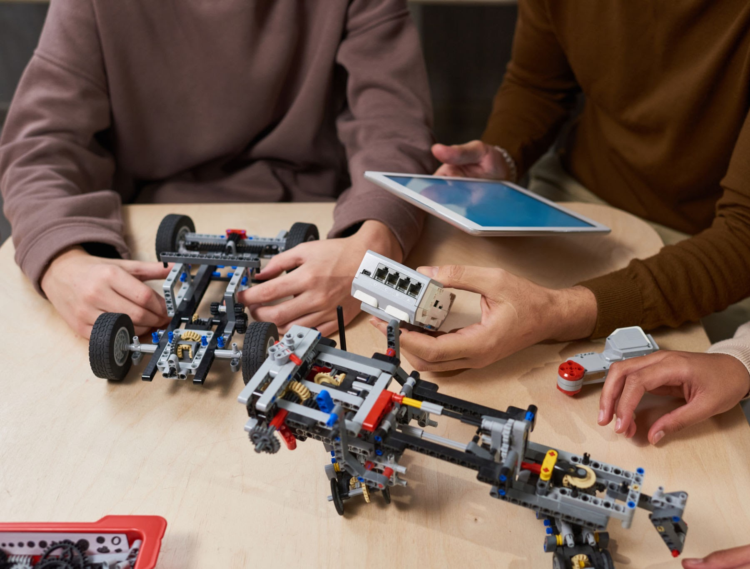
Documenting
A continuous effort
Notes:
Associate with last class

Slide 15

How to write useful documentation?
Exercise:
You will analyse a document and define what could be improved to actually achieve reproducibility.
2 groups according to expertise
Wet Lab
Data Analysis

Slide 16
How to write useful documentation?
Exercise: wet lab protocols The resulting emulsion was collected in aliquots of 50 μL total volume and thermocycled according to the RT program (42°C for 90 min, 11 cycles of [50°C for 2 min, 42°C for 2 min], 85°C for 5 min, followed by a final hold on 4°C). 125 μL of recovery agent (20% PFO in HFE), 55 μL of GITC Buffer (5 M GITC, 25 mM EDTA, 50 mM Tris-HCl pH 7.4) and 5 μL of 1 M DTT was added to each separate aliquot of 50 μL thermocycled emulsion and incubated on ice for 5 min.
Exercise: data analysis scripts Barcode reads were trimmed to exclude the intersub-barcode linear amplification adapters using a mawk script. Reads were then mapped and cell-demultiplexed using STARsolo (Kaminow et al., 2021) in CB_UMI_Complex mode. The resulting STARsolo-filtered count matrices were further analyzed using Scanpy (Wolf et al., 2018). In short, cells were filtered on expression of a maximum of 4000 genes, and a maximum of 1% UMIs from mitochondrial genes. Genes were filtered on expression in a minimum of three cells. Potential cell doublets were filtered out using a Scrublet (Wolock et al., 2019) threshold of 0.25.

Slide 17
Discussion of results:

Slide 18


How to write useful documentation?
Exercise: wet lab protocols The resulting emulsion was collected in aliquots of 50 μL total volume and thermocycled according to the RT program (42°C for 90 min, 11 cycles of [50°C for 2 min, 42°C for 2 min], 85°C for 5 min, followed by a final hold on 4°C). 125 μL of recovery agent (20% PFO in HFE), 55 μL of GITC Buffer (5 M GITC, 25 mM EDTA, 50 mM Tris-HCl pH 7.4) and 5 μL of 1 M DTT was added to each separate aliquot of 50 μL thermocycled emulsion and incubated on ice for 5 min.
Exercise: data analysis scripts Barcode reads were trimmed to exclude the intersub-barcode linear amplification adapters using a mawk script. Reads were then mapped and cell-demultiplexed using STARsolo (Kaminow et al., 2021) in CB_UMI_Complex mode. The resulting STARsolo-filtered count matrices were further analyzed using Scanpy (Wolf et al., 2018). In short, cells were filtered on expression of a maximum of 4000 genes, and a maximum of 1% UMIs from mitochondrial genes. Genes were filtered on expression in a minimum of three cells. Potential cell doublets were filtered out using a Scrublet (Wolock et al., 2019) threshold of 0.25.

Slide 19
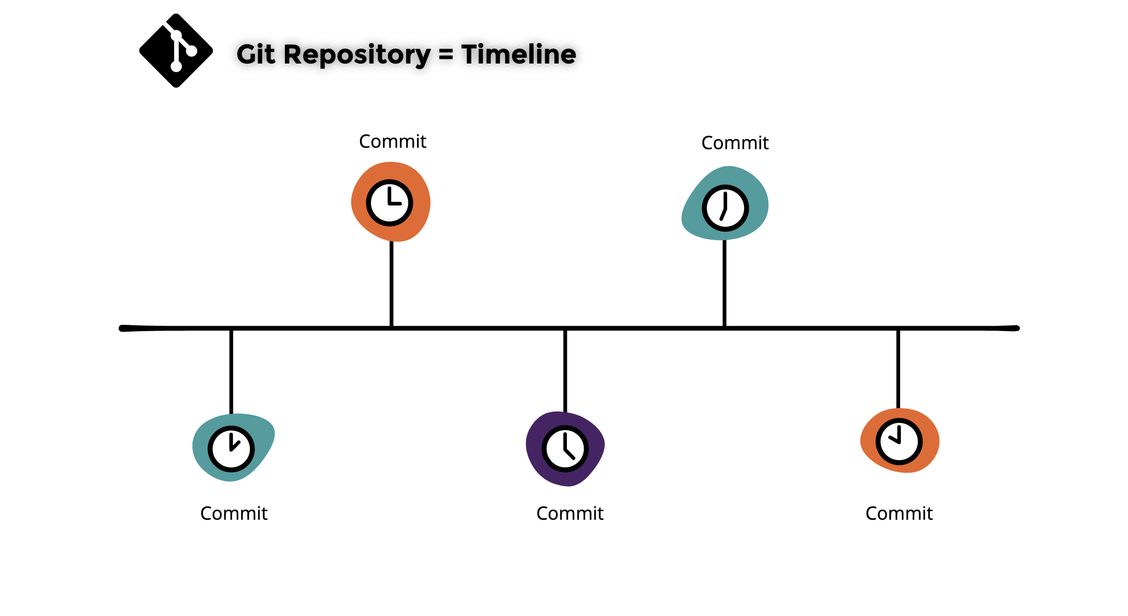
Data analysis scripts under version control
The best possible way of documenting scripts and code for software is using git and github (or alternative online ‘backup’ solution to github).
Illustration borrowed from the “Introduction to Git & GitHub” course by Bruna Pierecka and James Collier, ccby 4.0

Slide 20
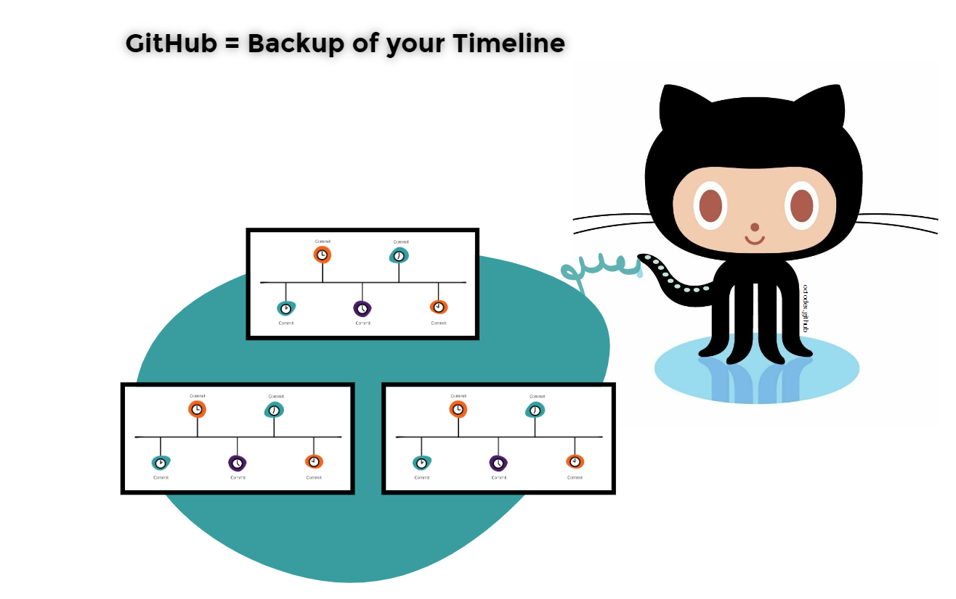
Data analysis scripts under version control
The best possible way of documenting scripts and code for software is using git and github (or alternative online backup solution to github).
Illustration borrowed from the “Introduction to Git & GitHub” course by Bruna Pierecka and James Collier, ccby 4.0
Notes:
git clone https://github.com/aertslab/hydrop_data_analysis.git
Launch ungit in the folder /Users/albot/hydrop_data_analysis

Slide 21
What’s in the paper? Zoom in on metadata
Data availability The data discussed in this publication have been deposited in NCBI's Gene Expression Omnibus and are accessible through GEO Series accession number GSE175684
A copy is available in the European Nucleotide Archive at PRJNA733185

Slide 22
What do you know about metadata?
?

Slide 23
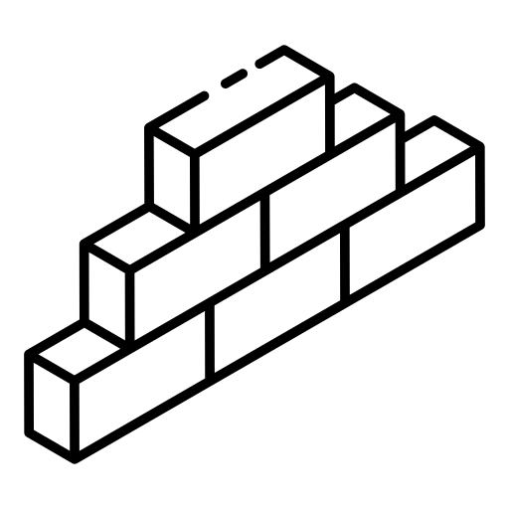


What is Metadata
Data to describe Data
Structured data
By smashingstocks
Descriptor with clear meaning
“Love note to the future about data”
By Iconsea
By Freepik
Slide borrowed from “Metadata and Findabilty” session, by Bruna Piereck and Alexander Botzki; from “FAIR material made by design” course, ccbysa
Notes:
https://www.freepik.com/icon/dictionary_12349225#fromView=search&page=1&position=11&uuid=947d3a74-8e87-4cba-952c-b5f3187bbd5c
https://www.freepik.com/icon/bricks_7007832#fromView=search&page=1&position=0&uuid=ab1d4a89-296c-44cd-89dc-5cc08e358eb4
https://www.freepik.com/icon/note_6546748#fromView=search&page=1&position=25&uuid=82875b0e-a9dc-4170-ad8f-bdc032877650
https://docs.google.com/presentation/d/1ZcFJpbXtxT4Qa6wgffV_oEX8_cZfzM8B-VlMH0Cff0I/edit#slide=id.g301c2976dd9_0_103

Slide 24









Data vs Metadata
Data itself
Data descriptor (metadata)
Notes:
Examples to help explaining:
In a plant experiment. Omics (DNA, RNA, Prot) are the data along with their measurements and annotation. Metadata are describing the data such as plant size, time and date of collection, temperature, maybe weather if not growing in a greenhouse, who collected, etc …
In another example if you are interviewing people to collect some data, like mental health history or cardiovascular diseases that you want to check the correlation with job and income, these are your data. However you might still have information on how data was collected, in which period of time it was collected, what is the nationality and ethnicity of these people, etc.

Slide 25









Data vs Metadata
Data itself
Data descriptor (metadata)
Notes:
Examples to help explaining:
In a plant experiment. Omics (DNA, RNA, Prot) are the data along with their measurements and annotation. Metadata are describing the data such as plant size, time and date of collection, temperature, maybe weather if not growing in a greenhouse, who collected, etc …
In another example if you are interviewing people to collect some data, like mental health history or cardiovascular diseases that you want to check the correlation with job and income, these are your data. However you might still have information on how data was collected, in which period of time it was collected, what is the nationality and ethnicity of these people, etc.

Slide 26
Data dictionaries and codebooks
Let’s explore this example The association between rainforest disturbance and recovery, tree community composition, and community traits in the Yangambi area in the Democratic Republic of the Congo
Information and data analyses and plots: https://zenodo.org/record/6979778#.Y5d1ZbLMKeM Publication: https://doi.org/10.1017/S0266467422000347

Slide 27


Data vs Metadata
Data itself
Data descriptor (metadata)
Human findable
Machine findable
Notes:
https://www.freepik.com/icon/search_1705952#fromView=search&page=1&position=70&uuid=c9baea82-896a-4cee-bab6-c0bbb3af08a1
https://www.freepik.com/icon/technological-support_2408695#fromView=search&page=1&position=0&uuid=e9efa965-f219-42be-9003-dfd577db3888
https://www.freepik.com/icon/search_1705952#fromView=search&page=1&position=70&uuid=c9baea82-896a-4cee-bab6-c0bbb3af08a1

Slide 28
How is Metadata structured
By juicy_fish
Machine findable
Notes:
https://www.freepik.com/icon/search_1705952#fromView=search&page=1&position=70&uuid=c9baea82-896a-4cee-bab6-c0bbb3af08a1
https://www.freepik.com/icon/technological-support_2408695#fromView=search&page=1&position=0&uuid=e9efa965-f219-42be-9003-dfd577db3888
https://www.freepik.com/icon/search_1705952#fromView=search&page=1&position=70&uuid=c9baea82-896a-4cee-bab6-c0bbb3af08a1

Slide 29
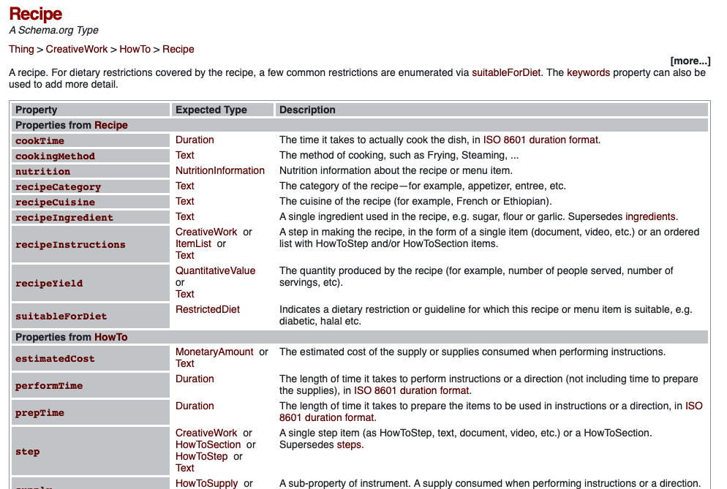
Type
Profile

Slide 30


How does metadata works?
Grey/Black Bed with Storage, Length 200-210cm, width between 180-190cm,
Notes:
Activity description:
https://docs.google.com/document/d/12RsLx2vb1xESykDdljbTKWad-ZTgnqx_48MtIm9NeaU/edit?usp=sharing

Slide 31
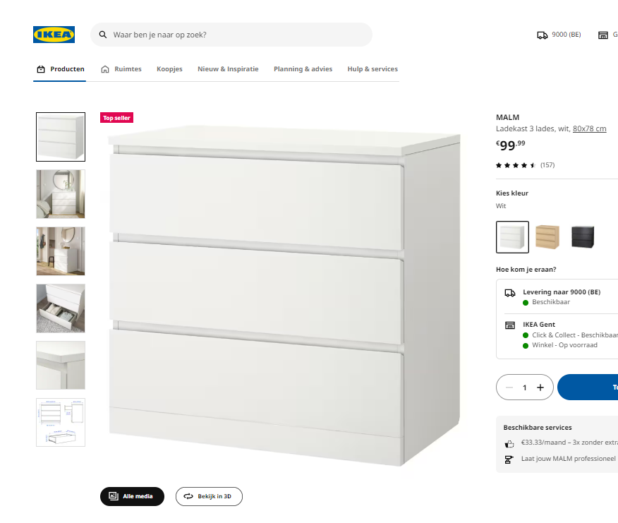
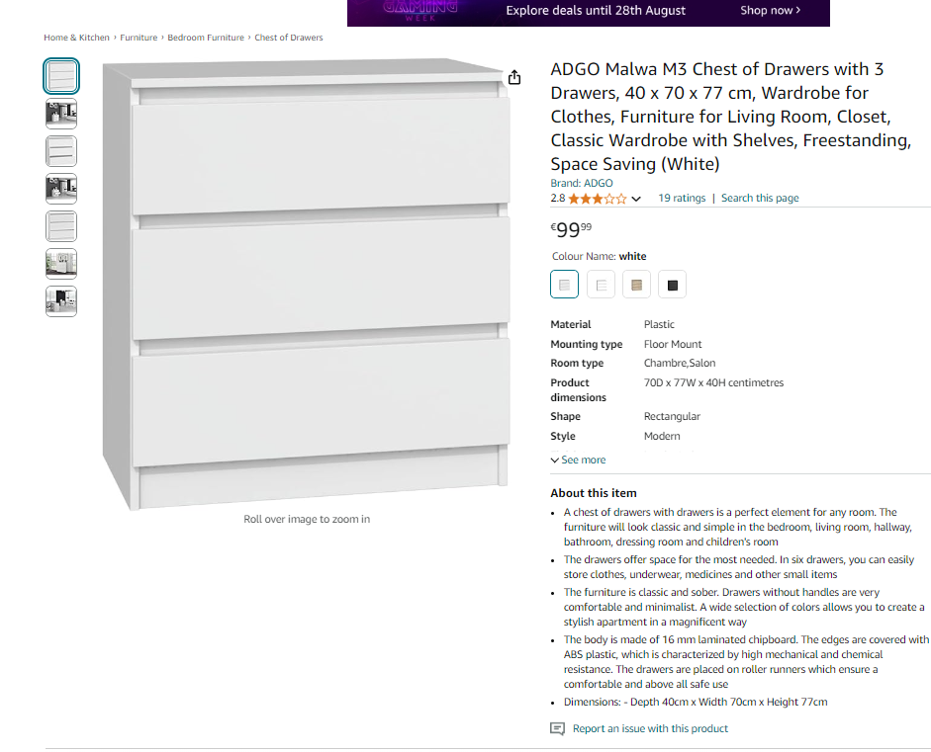

How does metadata works?
Notes:
Activity description:
https://docs.google.com/document/d/12RsLx2vb1xESykDdljbTKWad-ZTgnqx_48MtIm9NeaU/edit?usp=sharing

Slide 32

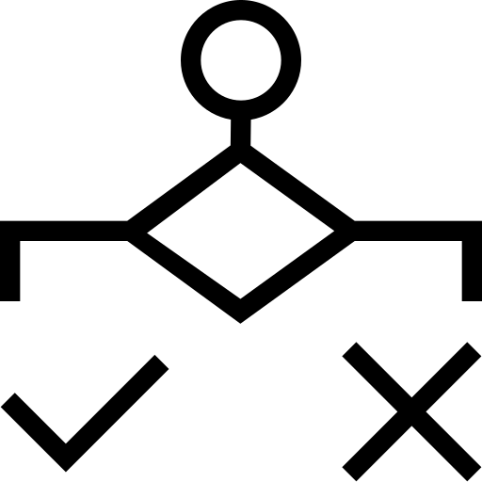
Metadata impact
Findability:
Findable by search engines
freepiik
juicy_fish
Sharing:
By UIcons
Structured information to evaluate
Targeted judgment
Evaluation on reusability
By UIcons
Decision making:
Slide borrowed from “Metadata and Findabilty” session, by Bruna Piereck and Alexander Botzki; from “FAIR material made by design” course, ccbysa
Notes:
https://www.freepik.com/icon/condition-alt_13727230
https://www.freepik.com/icon/together-people_15044474
https://docs.google.com/presentation/d/1ZcFJpbXtxT4Qa6wgffV_oEX8_cZfzM8B-VlMH0Cff0I/edit#slide=id.g301c2976dd9_0_8
https://www.freepik.com/icon/search_1705952#fromView=search&page=1&position=70&uuid=c9baea82-896a-4cee-bab6-c0bbb3af08a1
https://www.freepik.com/icon/technological-support_2408695#fromView=search&page=1&position=0&uuid=e9efa965-f219-42be-9003-dfd577db3888
https://www.freepik.com/icon/search_1705952#fromView=search&page=1&position=70&uuid=c9baea82-896a-4cee-bab6-c0bbb3af08a1

Slide 33
Ikea Ontologies
Let’s watch how Ikea approaches metadata.
https://zenodo.org/records/7908305

Slide 34
From metadata to data models
Let’s watch how Ikea approaches metadata.
https://zenodo.org/records/7908305

Slide 35
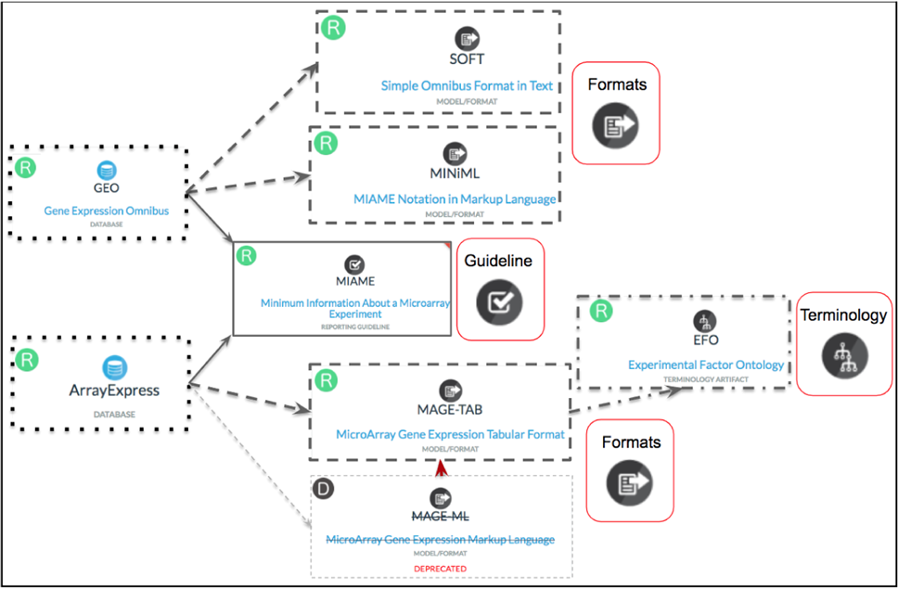
First a short excursion to nomenclature
Metadata model
Metadata checklist
https://doi.org/10.1038/s41597-022-01707-6

Slide 36

There are many metadata models
A metadata model is a structured framework that defines the types, relationships, and attributes of metadata within a specific context.
Essentially, it is a model that describes how metadata is organized and managed, providing a blueprint for how data about data is structured and utilized.
E.g. https://faircookbook.elixir-europe.org/content/recipes/infrastructure/dats-model.html

Slide 37
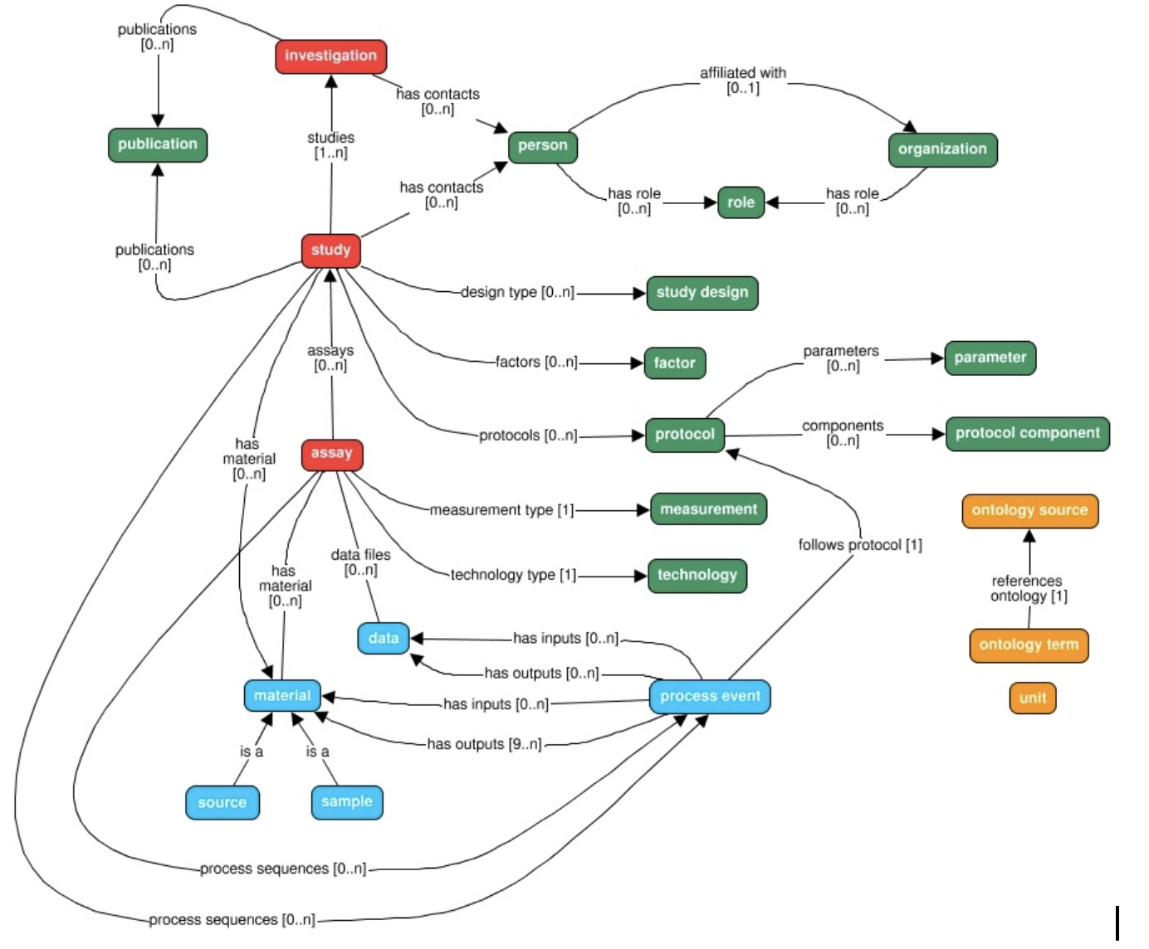
There are many metadata models
https://isa-tools.org/isa-api/_images/isa-model.png

Slide 38
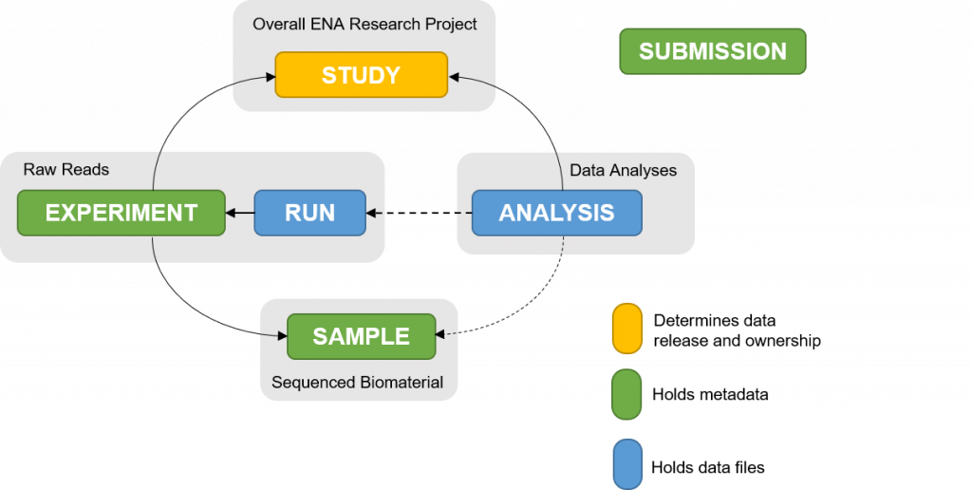
ENA’s metadata model
https://ena-docs.readthedocs.io/en/latest/submit/general-guide/metadata.html

Slide 39

Let’s focus on the metadata checklists
From ENA - their checklist of metadata
ELIXIR's Fair Cookbook for transcriptomics data
Exercise 3 Let’s fill in the metadata based on the paper

Slide 40
External references
Harvard Comparison Grid: https://datamanagement.hms.harvard.edu/electronic-lab-notebooks
NKI: LabGuru for Wetlab and Castor for Clinical Data Capature
MDC and BIH – LIMS is available, RDM SODAR (Omics data)

Slide 41
Documentation and support
VIB & ELIXIR Support
VIB Data Core - for e-lab journal (Follow training and Learn VIB support points)
eLab journal - 19Nov - Leuven
eLab journal - 09Dec - Gent
RDM more specific support should exist per center, taking their particularities in account
ELIXIR services - usegalaxy.eu More information at: https://www.elixir-belgium.org/services
Data Core Team Lead Data Management: flora.danna@vib.be

Slide 42





What did we cover today.
implement SOP type of approach for your daily documentation of experiments
describe the impact of documentation on the publication preparation
make versioning more persistent by using protocols.io and/or your Electronic Lab Notebook
use github for scripts and code
apply at least minimal metadata standards for domain-specific data

Slide 43
Our guide for today’s session
HyDrop-RNA single-cell library preparation
https://pubmed.ncbi.nlm.nih.gov/35195064/
Exercise 1 Documentation at project level

